Slide 1


Machine Learning Introduction

Slide 2

Shady Ahmed Bedier
Computer Science Lecturer Assistant
PhD Student Computer Science
Master of Statistics and Computer Science (2020)
Email : shady_bedier9135@yahoo.com
Phone: 01026170063
ITI/EPITA Train The Trainers of Artificial Intelligent (2021)
Advanced Data Analysis Udacity Nano Degree (2021)
Data Analysis Professional Udacity Nano Degree (2020)
Machine Learning Engineer Udacity Nano Degree (11-2019)
Microsoft Certified Professional Developer MCPD (2012)
professionally, I am a computer science teacher assistant over five years in the academic field. I doing my researches in Artificial Intelligent preparing and teaching courses (Mathematics, Statistics, Artificial intelligence, Machine Learning ,Computer Vision and Natural Language Processing).
I am extremely happy to share my knowledge and experience throughout my courses!

Slide 3
Use Python for Machine Learning
DATA ANALYSIS………3Lec-1Pro
Basics of Statistics and Linear Algebra
Learn to use NumPy for Numerical Data
Learn to use Matplotlib for Python Plotting
Using pandas Data Frames to solve complex tasks
Machine Learning
Introduction
Supervised
Machine Learning…4Lec-2Pro
Unsupervised Learning
Deep Learning introduction.
Deep Learning…2 Lec - 1 Project
Computer Vision implementation using Deep Learning

Slide 4
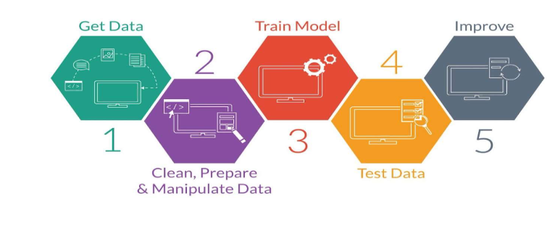
Machine Learning Workflow

Slide 5
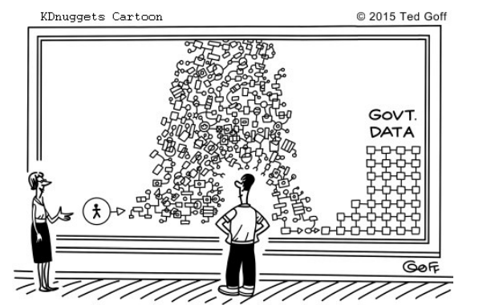
Before trying anything, you should know your data!

Slide 6
data analysis process

Slide 7
Step 1: Ask questions
Step 2: Wrangle data
Step 3: Perform EDA (Exploratory Data Analysis)
Step 4: Draw conclusions
Step 5: Communicate your results

Slide 8
Python is considered the standard language for data science is its powerful packages.
NumPy, Pandas, and Matplotlib
are three core packages for data analysis that we'll be learning to use in this course.

Slide 9
Step 1: Ask questions

Slide 10
Step 2: Wrangle data

Slide 11


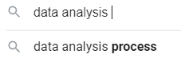


Data set types
Structured data set
CSV or Excel files
SQL databases
Unstructured data set
Text
Images
Audio

Slide 12
Step 3: Perform EDA (Exploratory Data Analysis)

Slide 13
Step 4: Draw conclusions

Slide 14
Step 5: Communicate your results

Slide 15
1-Causes & Impact of Missing Values

Slide 16
Important Concepts
Handling Missing Values.
Handling Outliers.
Learning some Important Data Manipulation Functions useful for Cleaning the Data.
How to Deal with Real World Problems.

Slide 17
Missing Value
Missing values occur when there is no data or value stored for the variable in an observation.
Missing data are a common occurrence and can have a significant effect on the conclusions drawn from the data.
There can be several causes for the occurence of missing values in a data set.

Slide 18
Example
The data collected from a survey can have missing values because some participants refuse to answer some or all of the questions or they do not know the answer to any question or the answer has been skipped.
Conclusion: Data can be missing due to Multiple Reasons such as accidental or data entry error.

Slide 19
Problems with Missing Data
Most statistical procedures require a value for each variable.
The missing data can cause a bias in the estimation of parameters and the accuracy of our machine learning model can be affected.

Slide 20
2-Types of Missing Values

Slide 21
Types of Missing Values
MCAR - Missing Completely At Random
The types of missing values are the values which are missing without any reason or pattern.
The values are missed randomly across the dataset and have no association with any other factor.

Slide 22
Types of Missing Values
MAR - Missing At Random
The missing values in this category have some association with other features of the dataset.
The variable which has missing values can be linearly related to any other variable of the dataset.

Slide 23
Types of Missing Values
MNAR - Missing Not At Random
These types of missing values are the values which are missing with some specific reasons.
And we will have a clear understanding and logic for the missing value.

Slide 24
3-Mode, Median, Mean

Slide 25
Mode
Having some missing values in a categorical variable called Gender.
Two Types of Values: Males and Females.
To Impute or Replace the Missing Values from such a Column we can use the Mode Function.
It returns the maximum occurring value. Which in turn can be used to Replace the Missing Values.

Slide 26
Median
We should impute the missing values in numerical variables using the Median function.
If there are outliers present in the data.
As the median function is not sensitive towards outliers.

Slide 27
Mean
We should use the “Mean” Function when the data does not contain any Outliers.
Mean Function is very sensitive towards Outliers.

Slide 28
3-Outliers

Slide 29
Outliers
Outliers are extreme values that fall a long way outside of the other observations.
Outliers are those Values which are very very different from most of the Values.
Example: There is a Column called “Age” for B.tech College.
Where students generally have age around 17 to 24.

Slide 30
BAD for Building Predictive Models?
Because these Outliers can Induce the state of Confusion in the Predictive Models, which in turn makes the Model very Weak for Making Decision Rules.
Then there are High Chances that the Model will not perform Good.

Slide 31
Reasons for having Outliers
Data Entry Errors
Measurement Errors
Experimental Errors
Sampling Errors
Natural Occurrence.

Slide 32
Outliers Sources
In the process of producing, collecting, processing and analyzing data, outliers can come from many sources and hide in any dimension.
Conclusion: Removal or Treatment of Outliers from the Data for Building a Predictive Model is very Important as many machine learning algorithms are sensitive to the range and distribution of attribute values in the input data.

Slide 33
4-Types Of Outliers

Slide 34
Types of Outliers
Univariate Outliers.
Bivariate Outliers.
Univariate Outliers are the points which are beyond the normal values in a single variable.
Bivariate Outliers are the points which lie far from the expected values when two variables are plotted against each other.

Slide 35
5-Winsorization

Slide 36
Winsorization
Winsorization is a way to minimize the influence of outliers in our data by either by Deleting the extreme observations of our data.
The Concept of Winsorization is based on the Concept of Normal Distribution.
Where It Tries to find out the Most Uncommon Observations and Treat them in the most appropriate way.

Slide 37
Winsorization in a Real world
To Analyze the data and try to find out the cause for the outliers in the dataset.
To Decide how much winsorization we want.
In General, We prefer the Winsorization of the top 5 percent and the bottom 5 percent of the dataset.
To Replace the extreme values by maximum or minimum values.

Slide 38
6-Deleting and Capping Outliers

Slide 39
Handling Outliers
Example:
The age variable in our dataset which predicts loan approval.
The normal range of age can be 15-60 years but there may be some people with age greater than 60.
So in this case, where people having age greater than 60 applied for the loan are not outliers, we can not simply delete them.

Slide 40
Deleting Outliers
We are sure that the outliers are due to an entry error or due to measurement error.
If the outliers create a significant relationship between two independent variables which is against the assumption of many of our machine learning algorithms.

Slide 41
Capping Outliers
Capping refers to replacing the outliers to a near value so that we can keep the point in our analysis and it also does not skew the data.
Note: Other than Deleting and Capping, there are two more ways of handling outliers.
Imputing.
Binning.

Slide 42
Ninja Tip
Imputing: If an outlier seems to be due to some mistake and we recognise the mistake.
Binning: It is the process of transforming numerical variables into categorical type.
Example: we can bin the age variable into categories such as 20-40, 40-60, 60-90 and above.

Slide 43
Data Manipulation Functions

Slide 44
Data Manipulation Function
There are four data manipulation functions: -
reindex
set_index
reset_index
sort_index

Slide 45
Encoding Techniques
Encoding data means converting categorical data into numerical data.

Slide 46
Types of Encoding Techniques
Label Encoding
Feature Mapping
One Hot Encoding
Binary Encoding
BaseN Encoding
Target Encoding

Slide 47
Label Encoding
Each category is assigned a value 1 through N
where N is the number of categories in the column.
State | Label Encoding
Goa | 1
Gujarat | 2
Punjab | 3

Slide 48
Feature Mapping
A feature mapping is a function which maps a data vector to a feature space.
It is used in the case of ordinal variables.
Size | Feature Encoding
Low | 1
High | 3
Medium | 2

Slide 49
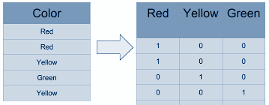
One Hot Encoding
We map each category to a vector that contains 1 or 0.The number of vectors depend on the number of categories.

Slide 50
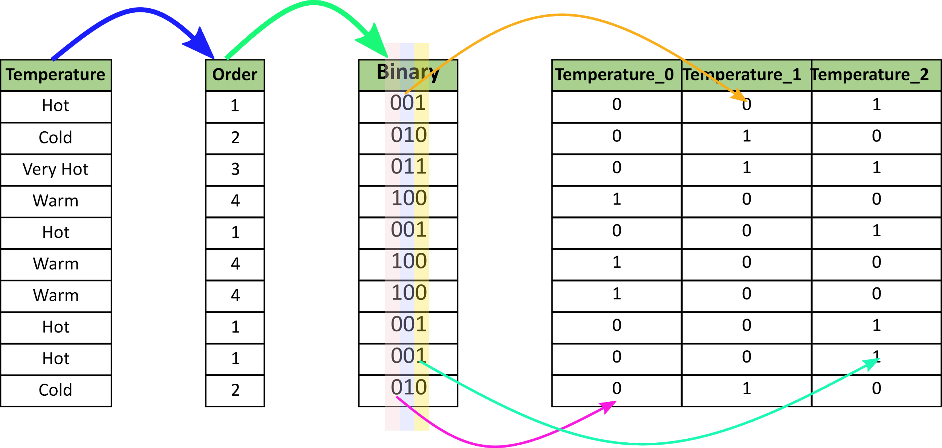
Binary Encoding
It converts a category into binary digits. Each binary digit creates one feature column.

Slide 51
BaseN Encoding
Generalising the value of N in log base N, we get BaseN Encoding.
When our Base is 1, It is One Hot Encoding.
When the Base is 2, It is Binary Encoding, and
If we want a Higher Base, we can use BaseN Encoding, which can be used for Columns where we have huge number of distinct Values.

Slide 52
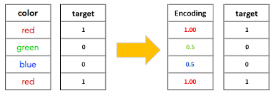
Target Encoding
Process of replacing a categorical value with any of the aggregation of the target variable.

Slide 53
THANKS
Any questions?

